Slide 1

The power of the 1% How just a few mediators keep society together
Tudor Andrei Marculesteanu, Roza Bracic, Marinde van Dijk, Aakash Pelapor Anandakrishnan

Slide 2





What is your drink preference?

Slide 3
Can the network reach consensus?

Slide 4
Can the network reach consensus?

Slide 5
Research Question(s)
Q1: Does introducing degrees of stubbornness that influence interactions between individuals (making the network heterogeneous) change the dynamics of the system?
Q2: Does introducing “mediators” that seek out disagreement change the dynamics of the system?
Does it reach consensus?
How long does it take to reach consensus?
What are the sizes of the different communities at consensus?

Slide 6
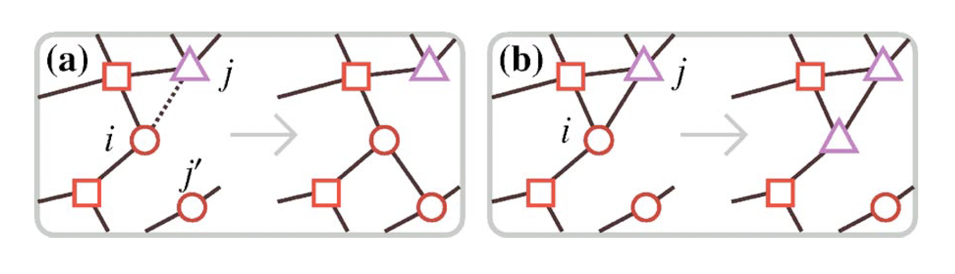
Base Model: Coevolution of opinions and connections
Holme & Newman (2006):
Nodes: Individuals, Edges = social connections, shape = opinion
At each step, pick a random individual i and a neighbour j (edge (i,j)
With probability φ: Rewire that edge to a random node with same opinion as i
With probability 1-φ: i adopts j's opinion
System evolves until no links connect disagreeing opinions
Outcome depends on φ: fragmentation vs global consensus
In agreement with papaer
Source without alcohol symbols:
Holme, P., & Newman, M. E. (2006). Nonequilibrium phase transition in the coevolution of networks and opinions. Physical Review E—Statistical, Nonlinear, and Soft Matter Physics, 74(5), 056108.

Slide 7
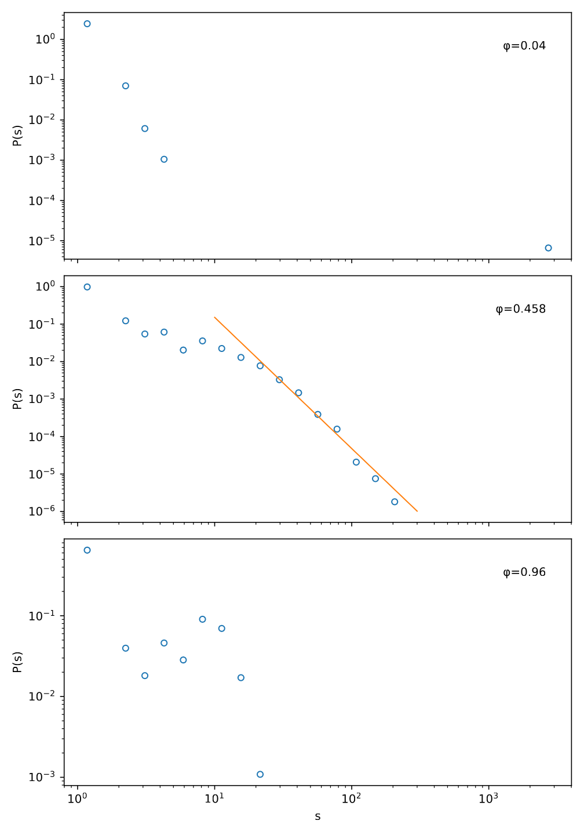
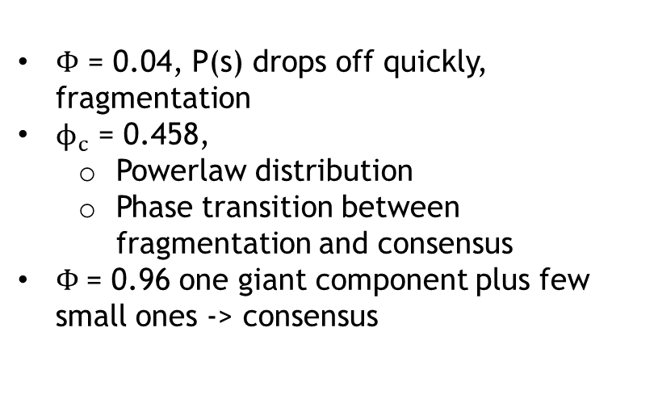
Community size distribution p(s)
$Φ$ = 0.04, P(s) drops off quickly, fragmentation
$ϕ_{c}$ = 0.458,
Powerlaw distribution
Phase transition between fragmentation and consensus
$Φ$= 0.96 one giant component plus few small ones -> consensus

Slide 8
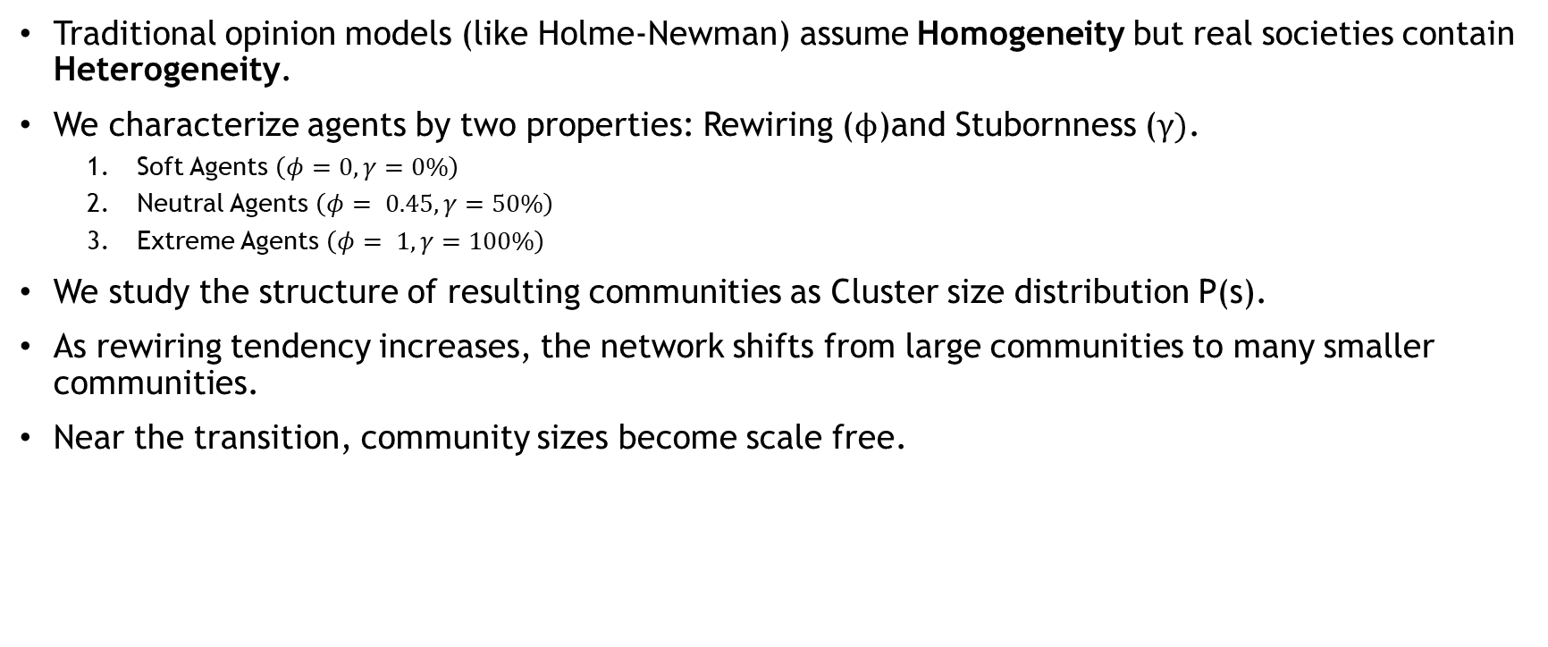
Heterogeneous Network
Traditional opinion models (like Holme-Newman) assume Homogeneity but real societies contain Heterogeneity.
We characterize agents by two properties: Rewiring ($ϕ$)and Stubornness ($γ)$.
Soft Agents $\left(φ=0,γ=0\%\right)$
Neutral Agents $\left(φ= 0.45,γ=50\%\right)$
Extreme Agents $\left(φ= 1,γ=100\%\right)$
We study the structure of resulting communities as Cluster size distribution P(s).
As rewiring tendency increases, the network shifts from large communities to many smaller communities.
Near the transition, community sizes become scale free.

Slide 9
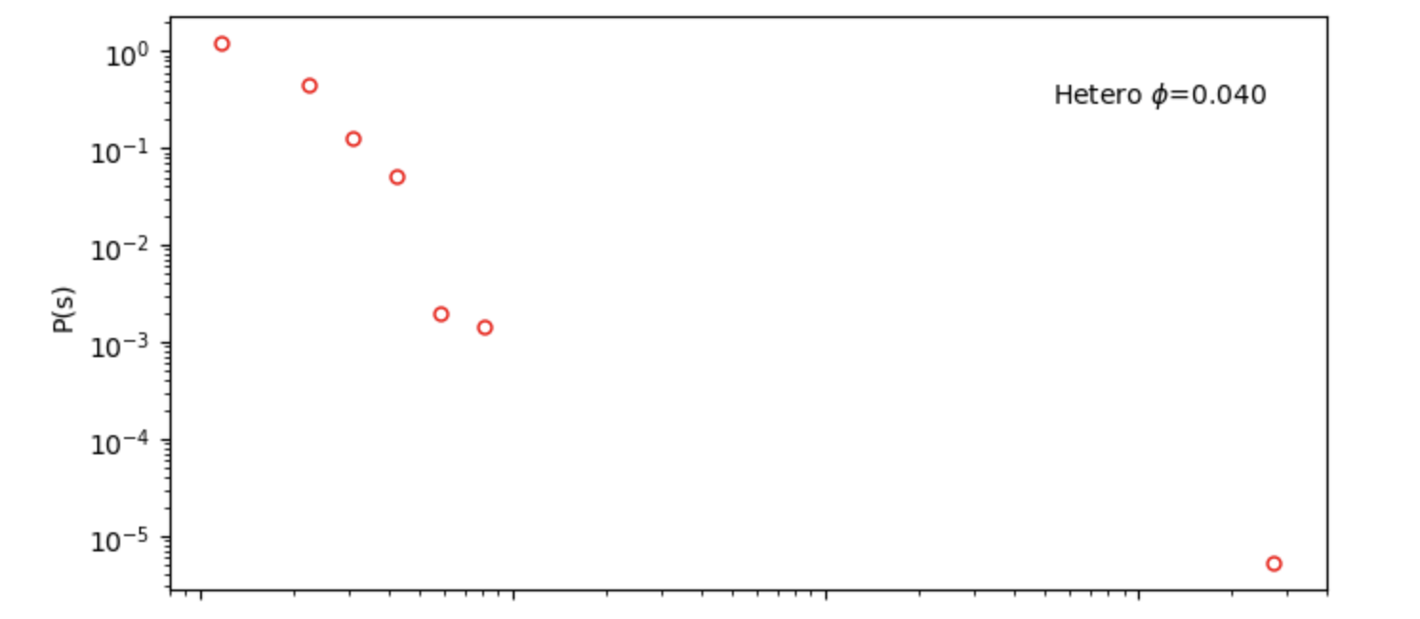
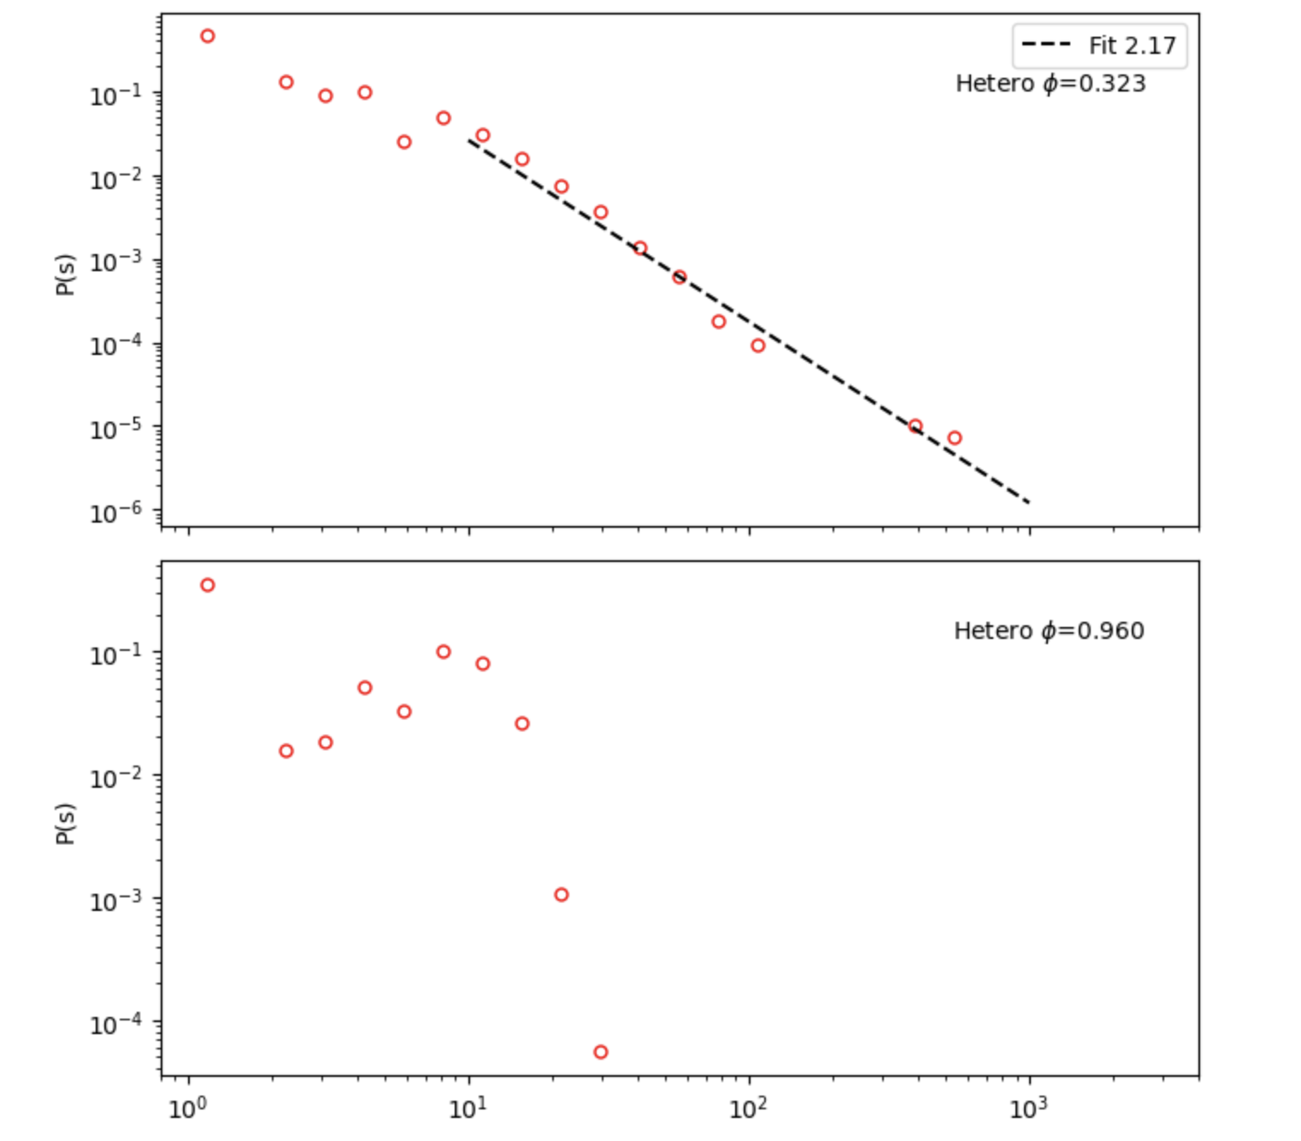
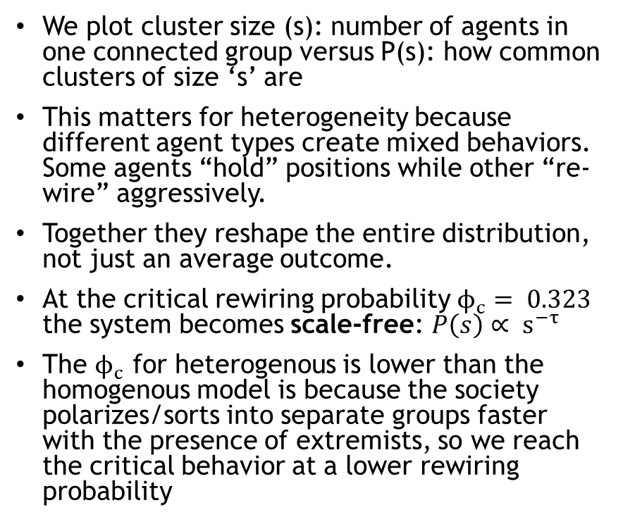
Power Law
We plot cluster size (s): number of agents in one connected group versus P(s): how common clusters of size ‘s’ are
This matters for heterogeneity because different agent types create mixed behaviors. Some agents “hold” positions while other “re-wire” aggressively.
Together they reshape the entire distribution, not just an average outcome.
At the critical rewiring probability $ϕ_{c}= 0.323$ the system becomes scale-free: $P\left(s\right)∝ s^{−τ}$
The $ϕ_{c}$ for heterogenous is lower than the homogenous model is because the society polarizes/sorts into separate groups faster with the presence of extremists, so we reach the critical behavior at a lower rewiring probability

Slide 10
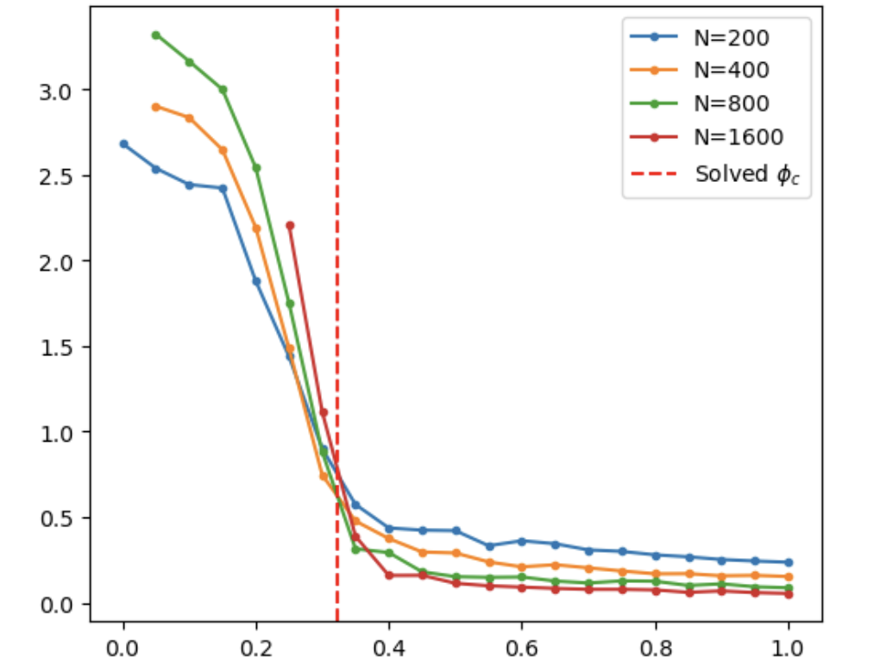
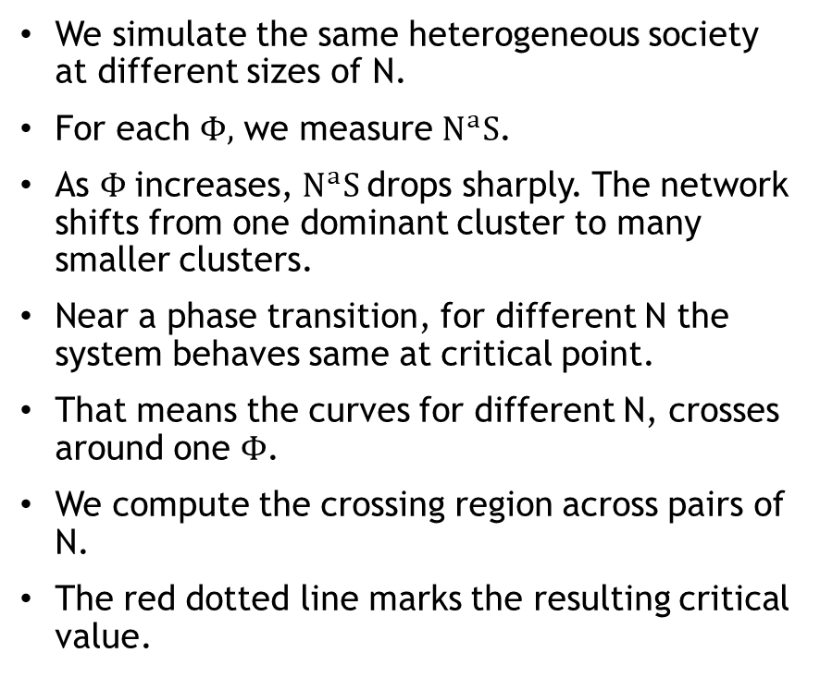
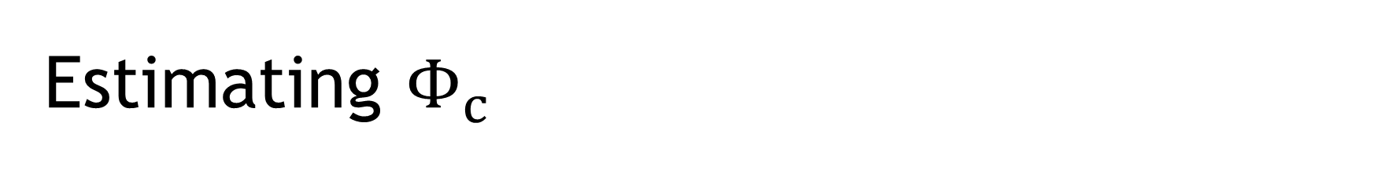
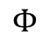
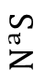
Estimating $Φ_{c}$
We simulate the same heterogeneous society at different sizes of N.
For each $Φ,$ we measure $N^{a}S$.
As $Φ$increases, $N^{a}S$drops sharply. The network shifts from one dominant cluster to many smaller clusters.
Near a phase transition, for different N the system behaves same at critical point.
That means the curves for different N, crosses around one $Φ$.
We compute the crossing region across pairs of N.
The red dotted line marks the resulting critical value.
$$N^{a}S$$
$$Φ$$

Slide 11
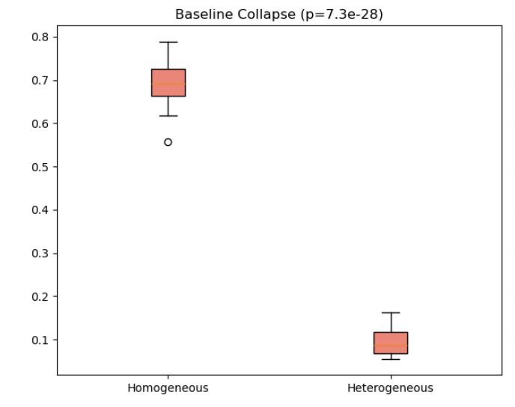
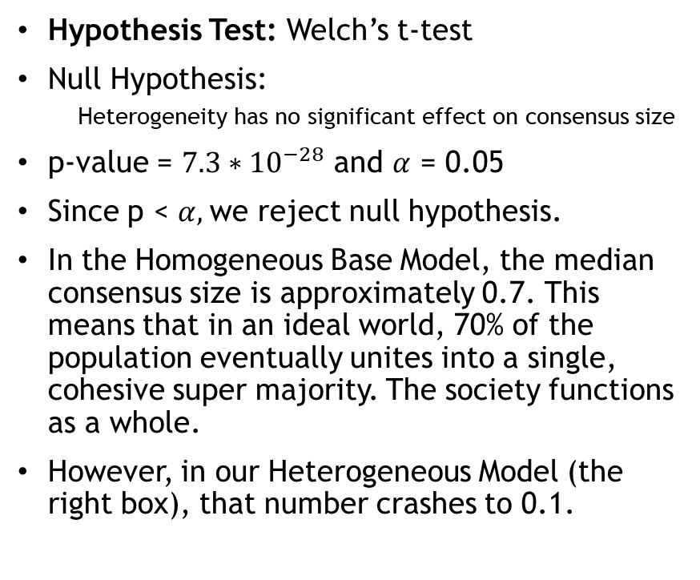
Statistical Analysis
Hypothesis Test: Welch’s t-test
Null Hypothesis:
Heterogeneity has no significant effect on consensus size
p-value = ${7.3∗10}^{−28}$ and $α$ = 0.05
Since p < $α,$we reject null hypothesis.
In the Homogeneous Base Model, the median consensus size is approximately 0.7. This means that in an ideal world, 70% of the population eventually unites into a single, cohesive super majority. The society functions as a whole.
However, in our Heterogeneous Model (the right box), that number crashes to 0.1.
Max.Consensus size

Slide 12

Q2: Adding Mediators
4th agent type
Φ value: 0.45, stubbornness: 0
Key difference: reconnect to holders of opposite beliefs
Idea: bridge the gap between groups of different beliefs
Hypothesis: increase in mediator population -> increase in total population interconnectivity

Slide 13
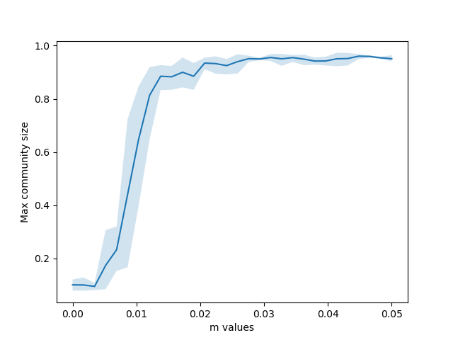
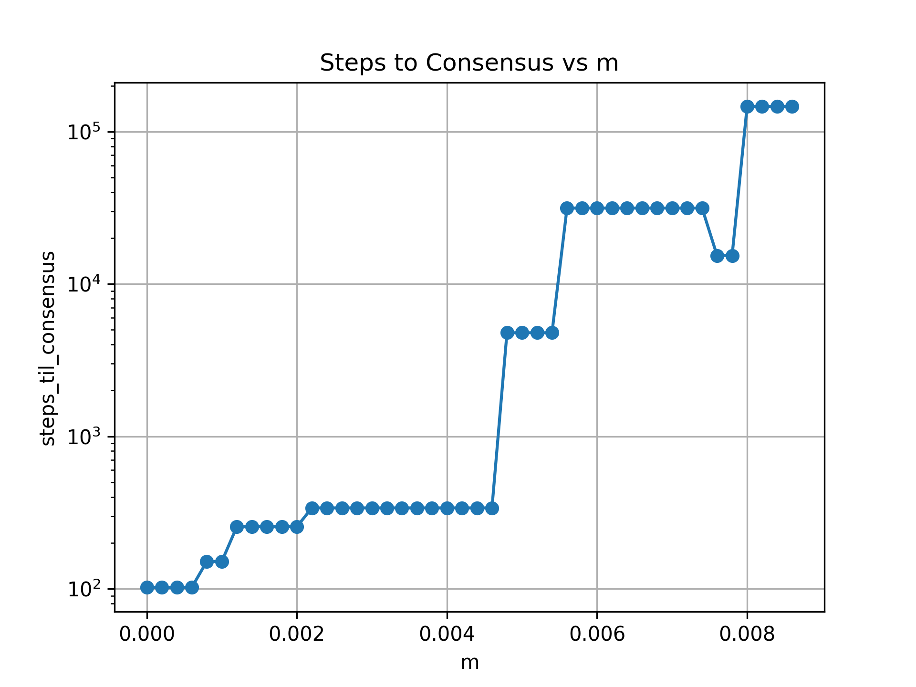
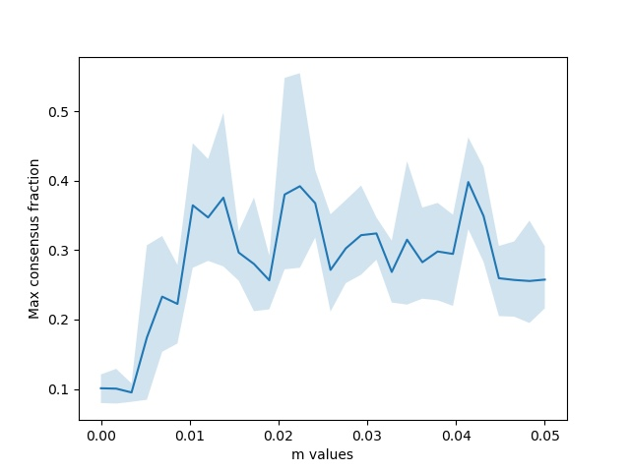
Results: Adding Mediators

Slide 14
Conclusion

